Slide 1
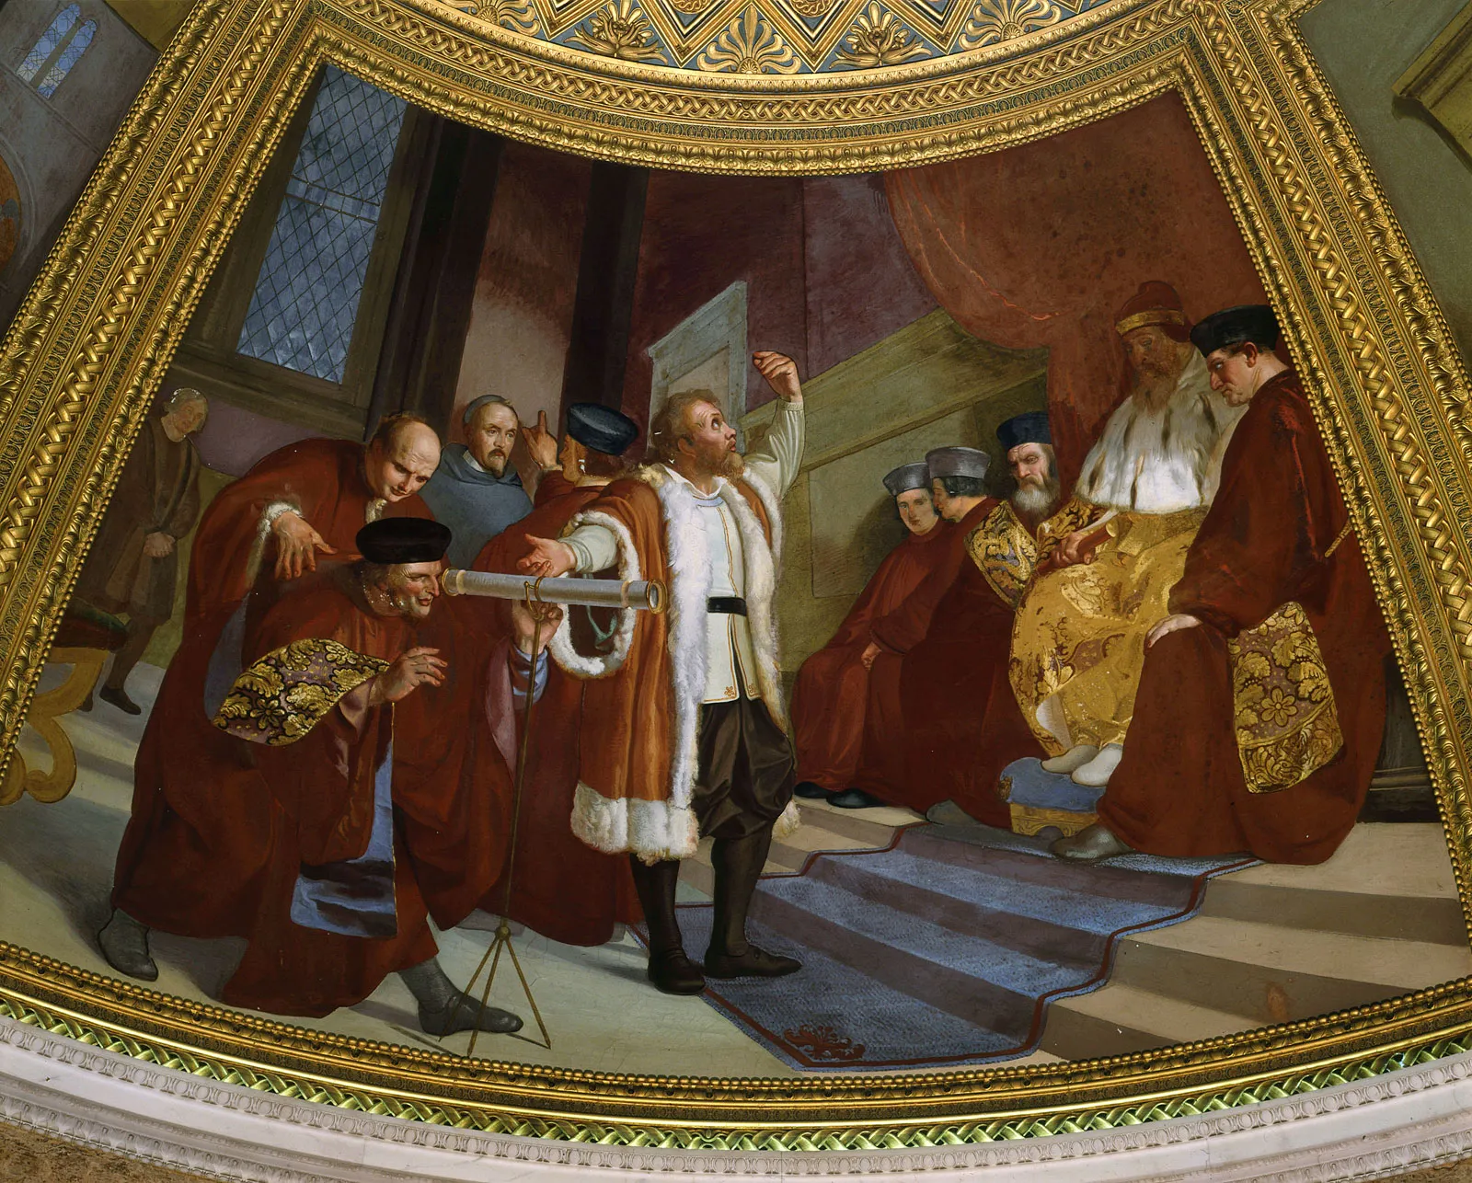
Replication/Revision/Rejection
Severe testing
Conclusion
L(M|D) ∝ P(D|M) Frequentist
P(M|D) ∝ P(D|M) · P(M) Bayesian
Causal claim
Effects
Causal inference
Galileo Galilei (1564-1642) the “father of modern science”
Data
Model
Inference algorithm
Statistical inference Machine learning
Observations
Predictions
P(D|M)
Natural process
Causal model
DGP model
Probability theory
Inductive reasoning
Real world
Abstract world
Propositional logic Deductive reasoning
Empiricism
Rationalism
Notes:
A probability model is the triplet (Ω, σ-algebra, P)
Generative vs Discriminative
Effects (of interventions) - counterfactual predictions

Slide 2
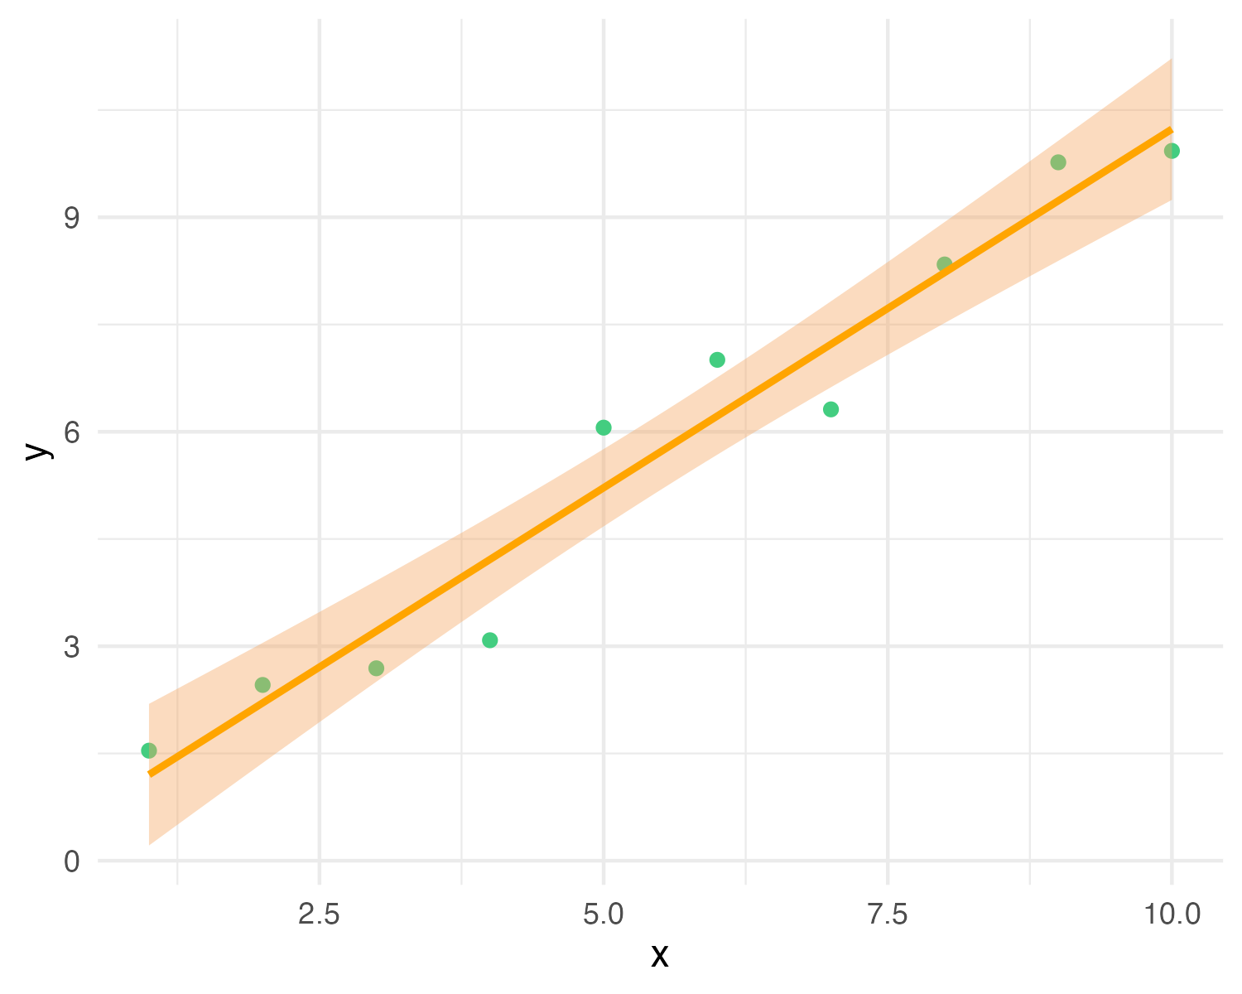
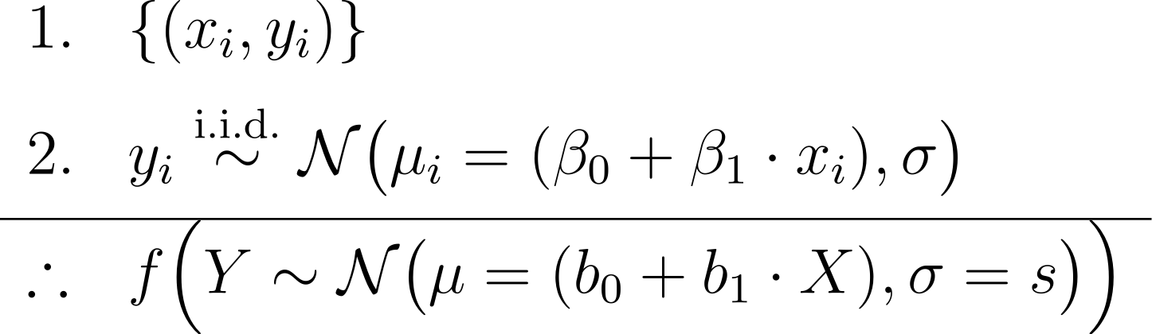
y_{i} ∼ N(μ_{i} = (β₀ + β₁ · x_{i}), σ)
premises
conclusion
Y = b₀ + b₁X with CI
Notes:
In Bayesian inference we add priors to the premises, and obtain a joint posterior distribution of the parameters conditioned on the data p(beta0, beta1, sigma | data), or a posterior predictive distribution as conclusion
In frequentist inference we obtain maximum-likelihood estimates of the parameters (b0, b1, s)
https://latex.unacademy.com/
\begin{array}{ll}
1. & \{(x_i, y_i)\} \\[6pt]
2. & y_i \stackrel{\text{i.i.d.}}{\sim} \mathcal{N}\bigl(\mu_i = (\beta_0 + \beta_1 \cdot x_i), \sigma\bigr) \\[4pt]
\hline
\therefore & f \Bigl(Y \sim \mathcal{N}\bigl(\mu = (b_0 + b_1 \cdot X), \sigma = s\bigr)\Bigr) \\
\end{array}

Slide 3
y_{i} ∼ N(μ_{i} = (β₀ + β₁ · x_{i}), σ)
premises assumptions evidence KB
premises
conclusion
Y = b₀ + b₁X with CI
Notes:
In Bayesian inference we add priors to the premises, and obtain a joint posterior distribution of the parameters conditioned on the data p(beta0, beta1, sigma | data), or a posterior predictive distribution as conclusion
In frequentist inference we obtain maximum-likelihood estimates of the parameters (b0, b1, s)
https://latex.unacademy.com/
\begin{array}{ll}
1. & \{(x_i, y_i)\} \\[6pt]
2. & y_i \stackrel{\text{i.i.d.}}{\sim} \mathcal{N}\bigl(\mu_i = (\beta_0 + \beta_1 \cdot x_i), \sigma\bigr) \\[4pt]
\hline
\therefore & f \Bigl(Y \sim \mathcal{N}\bigl(\mu = (b_0 + b_1 \cdot X), \sigma = s\bigr)\Bigr) \\
\end{array}

Slide 4
y_{i} ∼ N(μ_{i} = (β₀ + β₁ · x_{i}), σ)
premises assumptions evidence KB
premises
conclusion
Y = b₀ + b₁X with CI
= conclusion claim hypothesis query
Notes:
In Bayesian inference we add priors to the premises, and obtain a joint posterior distribution of the parameters conditioned on the data p(beta0, beta1, sigma | data), or a posterior predictive distribution as conclusion
In frequentist inference we obtain maximum-likelihood estimates of the parameters (b0, b1, s)
https://latex.unacademy.com/
\begin{array}{ll}
1. & \{(x_i, y_i)\} \\[6pt]
2. & y_i \stackrel{\text{i.i.d.}}{\sim} \mathcal{N}\bigl(\mu_i = (\beta_0 + \beta_1 \cdot x_i), \sigma\bigr) \\[4pt]
\hline
\therefore & f \Bigl(Y \sim \mathcal{N}\bigl(\mu = (b_0 + b_1 \cdot X), \sigma = s\bigr)\Bigr) \\
\end{array}

Slide 5
y_{i} ∼ N(μ_{i} = (β₀ + β₁ · x_{i}), σ)
premises assumptions evidence KB
premises
data
conclusion
Y = b₀ + b₁X with CI
= conclusion claim hypothesis query
Notes:
In Bayesian inference we add priors to the premises, and obtain a joint posterior distribution of the parameters conditioned on the data p(beta0, beta1, sigma | data), or a posterior predictive distribution as conclusion
In frequentist inference we obtain maximum-likelihood estimates of the parameters (b0, b1, s)
https://latex.unacademy.com/
\begin{array}{ll}
1. & \{(x_i, y_i)\} \\[6pt]
2. & y_i \stackrel{\text{i.i.d.}}{\sim} \mathcal{N}\bigl(\mu_i = (\beta_0 + \beta_1 \cdot x_i), \sigma\bigr) \\[4pt]
\hline
\therefore & f \Bigl(Y \sim \mathcal{N}\bigl(\mu = (b_0 + b_1 \cdot X), \sigma = s\bigr)\Bigr) \\
\end{array}

Slide 6
y_{i} ∼ N(μ_{i} = (β₀ + β₁ · x_{i}), σ)
premises assumptions evidence KB
premises
data
conclusion
likelihood(+ prior)
Y = b₀ + b₁X with CI
= conclusion claim hypothesis query
Notes:
In Bayesian inference we add priors to the premises, and obtain a joint posterior distribution of the parameters conditioned on the data p(beta0, beta1, sigma | data), or a posterior predictive distribution as conclusion
In frequentist inference we obtain maximum-likelihood estimates of the parameters (b0, b1, s)
https://latex.unacademy.com/
\begin{array}{ll}
1. & \{(x_i, y_i)\} \\[6pt]
2. & y_i \stackrel{\text{i.i.d.}}{\sim} \mathcal{N}\bigl(\mu_i = (\beta_0 + \beta_1 \cdot x_i), \sigma\bigr) \\[4pt]
\hline
\therefore & f \Bigl(Y \sim \mathcal{N}\bigl(\mu = (b_0 + b_1 \cdot X), \sigma = s\bigr)\Bigr) \\
\end{array}

Slide 7
y_{i} ∼ N(μ_{i} = (β₀ + β₁ · x_{i}), σ)
premises assumptions evidence KB
premises
data
conclusion
likelihood (+ prior)
Y = b₀ + b₁X with CI
= conclusion claim hypothesis query
Notes:
In Bayesian inference we add priors to the premises, and obtain a joint posterior distribution of the parameters conditioned on the data p(beta0, beta1, sigma | data), or a posterior predictive distribution as conclusion
In frequentist inference we obtain maximum-likelihood estimates of the parameters (b0, b1, s)
https://latex.unacademy.com/
\begin{array}{ll}
1. & \{(x_i, y_i)\} \\[6pt]
2. & y_i \stackrel{\text{i.i.d.}}{\sim} \mathcal{N}\bigl(\mu_i = (\beta_0 + \beta_1 \cdot x_i), \sigma\bigr) \\[4pt]
\hline
\therefore & f \Bigl(Y \sim \mathcal{N}\bigl(\mu = (b_0 + b_1 \cdot X), \sigma = s\bigr)\Bigr) \\
\end{array}

Slide 8
y_{i} ∼ N(μ_{i} = (β₀ + β₁ · x_{i}), σ)
premises assumptions evidence KB
premises
data
conclusion
likelihood (+ prior)
estimator
Y = b₀ + b₁X with CI
= conclusion claim hypothesis query
Notes:
In Bayesian inference we add priors to the premises, and obtain a joint posterior distribution of the parameters conditioned on the data p(beta0, beta1, sigma | data), or a posterior predictive distribution as conclusion
In frequentist inference we obtain maximum-likelihood estimates of the parameters (b0, b1, s)
https://latex.unacademy.com/
\begin{array}{ll}
1. & \{(x_i, y_i)\} \\[6pt]
2. & y_i \stackrel{\text{i.i.d.}}{\sim} \mathcal{N}\bigl(\mu_i = (\beta_0 + \beta_1 \cdot x_i), \sigma\bigr) \\[4pt]
\hline
\therefore & f \Bigl(Y \sim \mathcal{N}\bigl(\mu = (b_0 + b_1 \cdot X), \sigma = s\bigr)\Bigr) \\
\end{array}

Slide 9
y_{i} ∼ N(μ_{i} = (β₀ + β₁ · x_{i}), σ)
premises assumptions evidence KB
premises
data
conclusion
likelihood (+ prior)
estimator
Y = b₀ + b₁X with CI
MLE (or posterior) predictive model
= conclusion claim hypothesis query
Notes:
In Bayesian inference we add priors to the premises, and obtain a joint posterior distribution of the parameters conditioned on the data p(beta0, beta1, sigma | data), or a posterior predictive distribution as conclusion
In frequentist inference we obtain maximum-likelihood estimates of the parameters (b0, b1, s)
https://latex.unacademy.com/
\begin{array}{ll}
1. & \{(x_i, y_i)\} \\[6pt]
2. & y_i \stackrel{\text{i.i.d.}}{\sim} \mathcal{N}\bigl(\mu_i = (\beta_0 + \beta_1 \cdot x_i), \sigma\bigr) \\[4pt]
\hline
\therefore & f \Bigl(Y \sim \mathcal{N}\bigl(\mu = (b_0 + b_1 \cdot X), \sigma = s\bigr)\Bigr) \\
\end{array}

Slide 10
y_{i} ∼ N(μ_{i} = (β₀ + β₁ · x_{i}), σ)
premises assumptions evidence KB
premises
data
conclusion
likelihood (+ prior)
estimator
Y = b₀ + b₁X with CI
MLE (or posterior) predictive model
estimate
= conclusion claim hypothesis query
Notes:
In Bayesian inference we add priors to the premises, and obtain a joint posterior distribution of the parameters conditioned on the data p(beta0, beta1, sigma | data), or a posterior predictive distribution as conclusion
In frequentist inference we obtain maximum-likelihood estimates of the parameters (b0, b1, s)
https://latex.unacademy.com/
\begin{array}{ll}
1. & \{(x_i, y_i)\} \\[6pt]
2. & y_i \stackrel{\text{i.i.d.}}{\sim} \mathcal{N}\bigl(\mu_i = (\beta_0 + \beta_1 \cdot x_i), \sigma\bigr) \\[4pt]
\hline
\therefore & f \Bigl(Y \sim \mathcal{N}\bigl(\mu = (b_0 + b_1 \cdot X), \sigma = s\bigr)\Bigr) \\
\end{array}

Slide 11
y_{i} ∼ N(μ_{i} = (β₀ + β₁ · x_{i}), σ)
premises assumptions evidence KB
premises
data
causal model
conclusion
likelihood (+ prior)
estimator
Y = b₀ + b₁X with CI
MLE (or posterior) predictive model
effect
= conclusion claim hypothesis query
Notes:
In Bayesian inference we add priors to the premises, and obtain a joint posterior distribution of the parameters conditioned on the data p(beta0, beta1, sigma | data), or a posterior predictive distribution as conclusion
In frequentist inference we obtain maximum-likelihood estimates of the parameters (b0, b1, s)
https://latex.unacademy.com/
\begin{array}{ll}
1. & \{(x_i, y_i)\} \\[6pt]
2. & y_i \stackrel{\text{i.i.d.}}{\sim} \mathcal{N}\bigl(\mu_i = (\beta_0 + \beta_1 \cdot x_i), \sigma\bigr) \\[4pt]
\hline
\therefore & f \Bigl(Y \sim \mathcal{N}\bigl(\mu = (b_0 + b_1 \cdot X), \sigma = s\bigr)\Bigr) \\
\end{array}

Slide 12
“inductive” mode
y_{i} ∼ N(μ_{i} = (β₀ + β₁ · x_{i}), σ)
premises assumptions evidence KB
premises
data
causal model
conclusion
likelihood (+ prior)
estimator
Y = b₀ + b₁X with CI
MLE (or posterior) predictive model
effect
= conclusion claim hypothesis query
Notes:
In Bayesian inference we add priors to the premises, and obtain a joint posterior distribution of the parameters conditioned on the data p(beta0, beta1, sigma | data), or a posterior predictive distribution as conclusion
In frequentist inference we obtain maximum-likelihood estimates of the parameters (b0, b1, s)
https://latex.unacademy.com/
\begin{array}{ll}
1. & \{(x_i, y_i)\} \\[6pt]
2. & y_i \stackrel{\text{i.i.d.}}{\sim} \mathcal{N}\bigl(\mu_i = (\beta_0 + \beta_1 \cdot x_i), \sigma\bigr) \\[4pt]
\hline
\therefore & f \Bigl(Y \sim \mathcal{N}\bigl(\mu = (b_0 + b_1 \cdot X), \sigma = s\bigr)\Bigr) \\
\end{array}

Slide 13
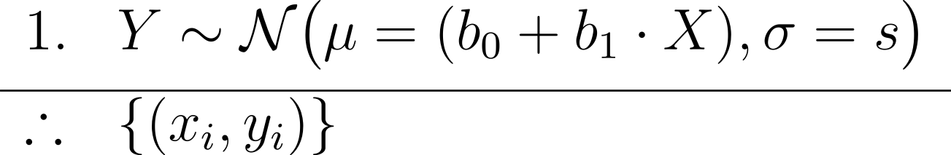
“hypothetico-deductive” mode
y_{i} ∼ N(μ_{i} = (β₀ + β₁ · x_{i}), σ)
premises assumptions evidence KB
premises
causal model
conclusion
predictive model
Y = b₀ + b₁X with CI
= conclusion claim hypothesis query
Notes:
In Bayesian inference we add priors to the premises, and obtain a joint posterior distribution of the parameters conditioned on the data p(beta0, beta1, sigma | data), or a posterior predictive distribution as conclusion
In frequentist inference we obtain maximum-likelihood estimates of the parameters (b0, b1, s)
https://latex.unacademy.com/
\begin{array}{ll}
1. & Y \sim \mathcal{N}\bigl(\mu = (b_0 + b_1 \cdot X), \sigma = s\bigr)
\\[4pt]
\hline
\therefore & \{(x_i, y_i)\} \\
\end{array}

Slide 14
“hypothetico-deductive” mode
y_{i} ∼ N(μ_{i} = (β₀ + β₁ · x_{i}), σ)
premises assumptions evidence KB
premises
causal model
conclusion
predictive model
Y = b₀ + b₁X with CI
predictions
= conclusion claim hypothesis query
Notes:
In Bayesian inference we add priors to the premises, and obtain a joint posterior distribution of the parameters conditioned on the data p(beta0, beta1, sigma | data), or a posterior predictive distribution as conclusion
In frequentist inference we obtain maximum-likelihood estimates of the parameters (b0, b1, s)
https://latex.unacademy.com/
\begin{array}{ll}
1. & Y \sim \mathcal{N}\bigl(\mu = (b_0 + b_1 \cdot X), \sigma = s\bigr)
\\[4pt]
\hline
\therefore & \{(x_i, y_i)\} \\
\end{array}

Slide 15
“hypothetico-deductive” mode
y_{i} ∼ N(μ_{i} = (β₀ + β₁ · x_{i}), σ)
premises assumptions evidence KB
premises
causal model
conclusion
predictive model
Y = b₀ + b₁X with CI
training data/past observations (model checking)
predictions
= conclusion claim hypothesis query
Notes:
In Bayesian inference we add priors to the premises, and obtain a joint posterior distribution of the parameters conditioned on the data p(beta0, beta1, sigma | data), or a posterior predictive distribution as conclusion
In frequentist inference we obtain maximum-likelihood estimates of the parameters (b0, b1, s)
https://latex.unacademy.com/
\begin{array}{ll}
1. & Y \sim \mathcal{N}\bigl(\mu = (b_0 + b_1 \cdot X), \sigma = s\bigr)
\\[4pt]
\hline
\therefore & \{(x_i, y_i)\} \\
\end{array}

Slide 16
“hypothetico-deductive” mode
y_{i} ∼ N(μ_{i} = (β₀ + β₁ · x_{i}), σ)
premises assumptions evidence KB
premises
causal model
conclusion
predictive model
Y = b₀ + b₁X with CI
test data/future observations (aim for severe testing)
predictions
= conclusion claim hypothesis query
Notes:
In Bayesian inference we add priors to the premises, and obtain a joint posterior distribution of the parameters conditioned on the data p(beta0, beta1, sigma | data), or a posterior predictive distribution as conclusion
In frequentist inference we obtain maximum-likelihood estimates of the parameters (b0, b1, s)
https://latex.unacademy.com/
\begin{array}{ll}
1. & Y \sim \mathcal{N}\bigl(\mu = (b_0 + b_1 \cdot X), \sigma = s\bigr)
\\[4pt]
\hline
\therefore & \{(x_i, y_i)\} \\
\end{array}

Slide 17
“hypothetico-deductive” mode
y_{i} ∼ N(μ_{i} = (β₀ + β₁ · x_{i}), σ)
premises assumptions evidence KB
premises
causal model
conclusion
predictive model
Y = b₀ + b₁X with CI
effects of interventions
causal predictions
= conclusion claim hypothesis query
Notes:
In Bayesian inference we add priors to the premises, and obtain a joint posterior distribution of the parameters conditioned on the data p(beta0, beta1, sigma | data), or a posterior predictive distribution as conclusion
In frequentist inference we obtain maximum-likelihood estimates of the parameters (b0, b1, s)
https://latex.unacademy.com/
\begin{array}{ll}
1. & Y \sim \mathcal{N}\bigl(\mu = (b_0 + b_1 \cdot X), \sigma = s\bigr)
\\[4pt]
\hline
\therefore & \{(x_i, y_i)\} \\
\end{array}

Slide 18
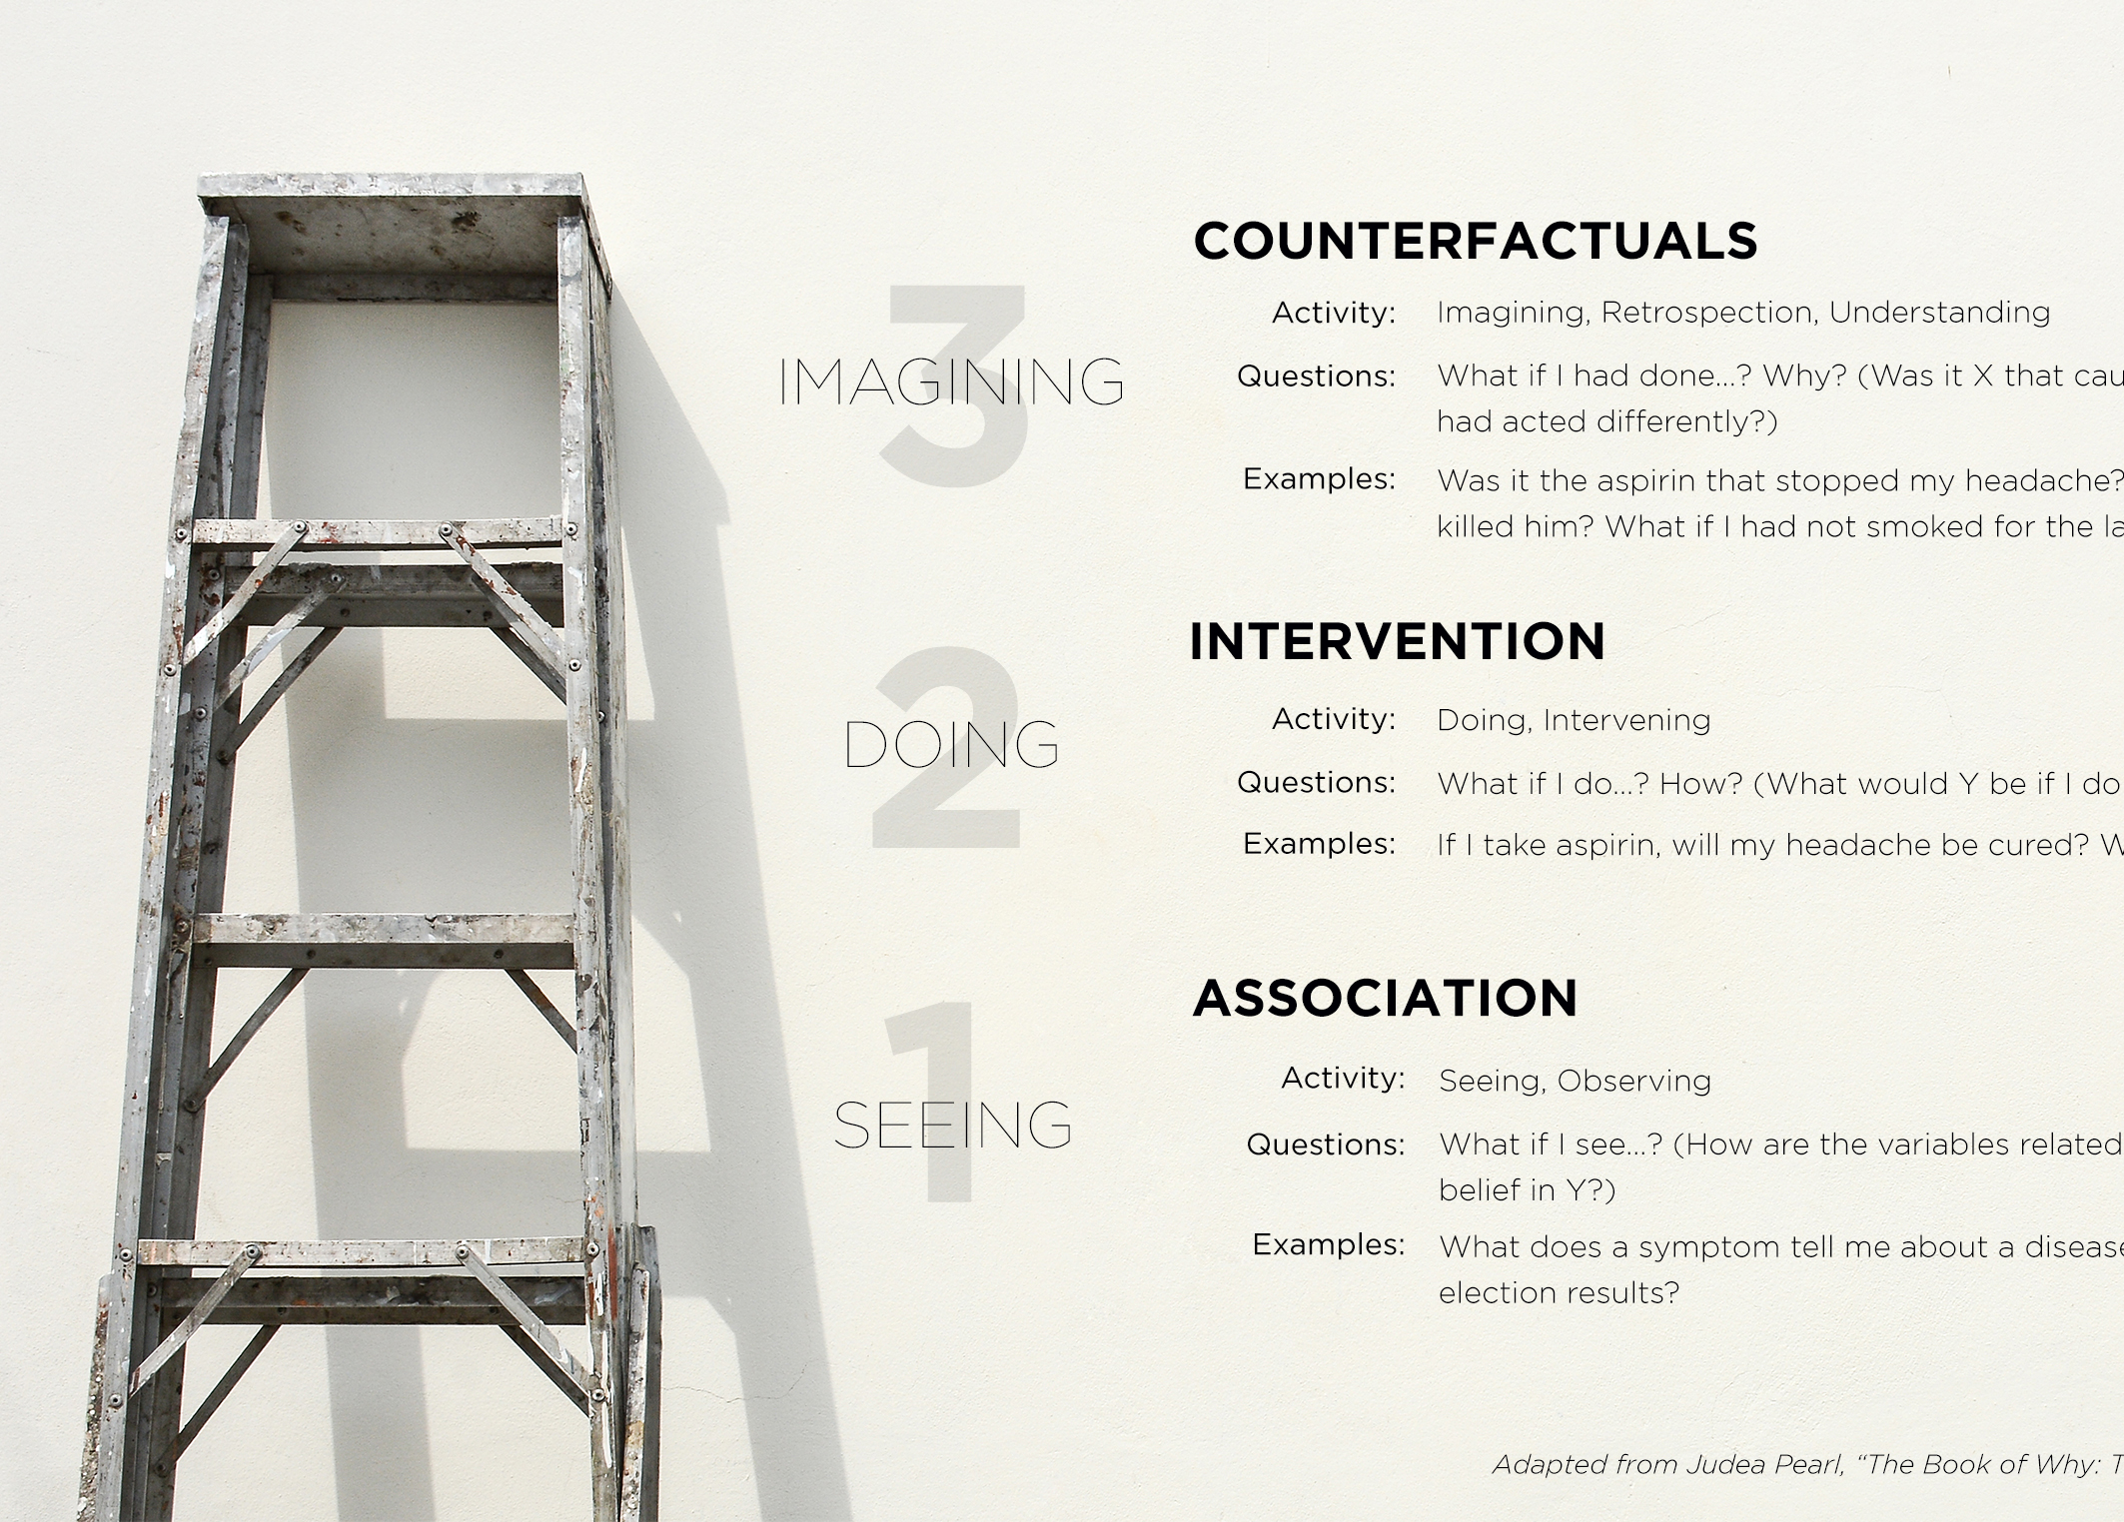
Why? Was it X that caused Y? P( y_{x} | x’, y’)
prob of observing Y = y had X been x, given we actually observed X = x’ and Y = y’
What if I do X?
P(y | do(x))
prob of observing Y = y given we intervened to set X = x
What if I see X? How would seeing X change my belief in Y?
P(y | x)
prob of observing Y = y given we observed X = x

Slide 19
Quantities of interest
Descriptive inferences
Predictive inferences
Descriptive statistics
Statistical inferences
Causal inferences
Data summaries
data + statistical model
(associations/statistical relationships)
data + favstats
data + statistical model + causal model
(effects/causal relationships)

Slide 20
